Slide 1
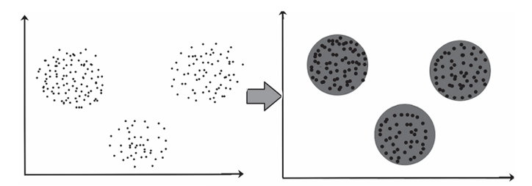
Clustering with Python
Clustering is a form of unsupervised learning. In unsupervised learning, the features of a dataset are modeled without any label references.
Clustering is the process of dividing the data points into many clusters in such a way that data points in the same clusters are more similar to other data points in the same cluster and are different from data points in other clusters.
It is generally a compilation of objects in terms of similarity and dissimilarity among them.
For example, the data points clustered together in the graph below can be classified into one single group. We can distinguish the clusters, and we can identify that there are two clusters in the figure.
There are various clustering algorithms in ML.
The following are the most common clustering techniques used in data science:
k-Means clustering
Agglomerative clustering
DBSCAN clustering
Clustering

Slide 2
k-Means clustering algorithm
The simplest unsupervised learning algorithm is the k-means clustering algorithm.
k-Means clustering comes under the partitioning method of clustering.
k-Means algorithm classifies “n” observations in “k” clusters where each observation lies to a cluster where the nearest mean serves as a cluster prototype.
Suppose we are given a database of “n” objects and the partitioning method constructs “k” partition of data, each partition will represent a cluster and k ≤ n.
It means that it will classify the data into “k” groups, which satisfies the following requirements:
Each group contains at least one object.
Each object must belong to exactly one group.

Slide 3
k-Means clustering algorithm
Steps
k-Objects from the dataset are randomly assigned as cluster centers.
Based on the mean values, reassign each object to its most similar object(cluster).
With the updated values, recalculate the mean of the cluster.
Repeat Step 4 until no change is observed.
k-Means clustering is very simple to be implemented in Python using scikit-learn.
In the code snippet below, we created an artificial dataset using make_blobs. To use the k-means class in Python, we need to import it from the sklearn. cluster.
Set the value of “k” in the n_cluster parameter, and .then run the algorithm by calling the fit method.

Slide 4
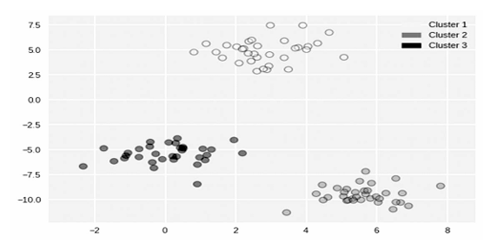
k-Means clustering algorithm
from sklearn.datasets import make_blobs
fromsklearn.cluster import KMeans
fromadspy_shared_utilities import plot_labelled_scatter X, y =make_blobs(random_state = 10)
kmeans = KMeans(n_clusters = 3)
kmeans.fit(X)
plot_labelled_scatter(X, kmeans.labels_, ['Cluster 1', 'Cluster 2', 'Cluster 3'])
k-Means clustering

Slide 5
Agglomerative clustering
Agglomerative approach is a type of a hierarchical method of clustering.
The clusters here are formed in a tree structure based on hierarchy. This approach is also known as the bottom-up approach.
In this, we start with each object forming a separate group.
It keeps on merging the objects or groups that are close to one another.
It keeps on doing so until all of the groups are merged into one or until the termination condition holds.
Linkage criteria for agglomerative clustering:
Ward’s Method – This method looks for two clusters, giving the least increase in total variance among all clusters, and then merge them.
Average Linkage – Average linkage search for two clusters to merge which has the least average distance between the points.
Complete Linkage – This linkage, also called the maximum linkage, looks for two clusters having the maximum distance between points to be merged.

Slide 6
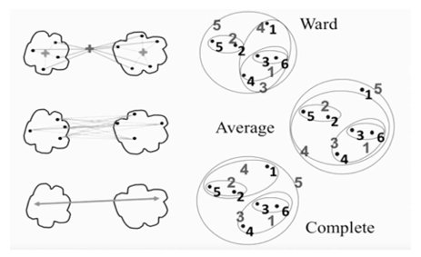
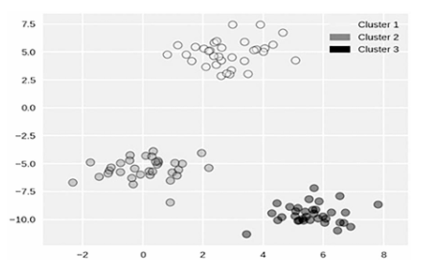
Agglomerative clustering
Ward’s method is usually compatible with most of the datasets, but if you want variety in the sizes of the clusters, the complete and average linkage can be used.
from sklearn.datasets import make_blobs fromsklearn.cluster import AgglomerativeClustering fromadspy_shared_utilities import plot_labelled_scatter X, y = make_blobs(random_state = 10)
cls = AgglomerativeClustering(n_clusters = 3) cls_assignment = cls.fit_predict(X) plot_labelled_scatter(X, cls_assignment, ['Cluster 1', 'Cluster 2', 'Cluster 3'])
Linkage criteria for agglomerative clustering
Agglomerative clustering

Slide 7
DBSCAN clustering
DBSCAN is an acronym for the density-based spatial clustering of applications with noise.
In DBSCAN, one need not specify the num of clusters in advance.
Also, DBSCAN is well suited for datasets with complex cluster shapes. In the DBSCAN method, clusters refer to the area that is denser in the data space, being isolated by the areas which are much less densely populated or empty.
Minimum points (MinPts) and epsilon (eps) play a very important role in the DBSCAN algorithm. Points lying in the larger dense region are referred to as core samples.
The core samples which are apart by a distance of eps units are put into one cluster. After the points being distinguished as core samples, the data points not making it into any cluster are said to be as noise.
Boundary points are the points that fall within the eps units’ distance but cannot be termed as core points in themselves.
Same as that of the other clustering methods, DBSCAN is imported from the scikit-learn cluster library.

Slide 8
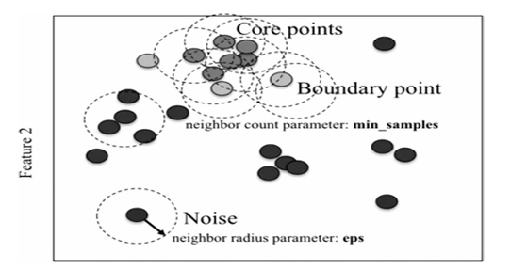
DBSCAN clustering
DBSCAN clustering

Slide 9
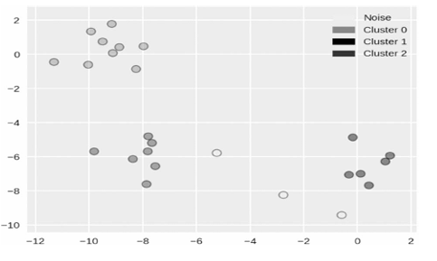
DBSCAN clustering
from sklearn.cluster import DBSCAN
fromsklearn.datasets import make_blobs
X, y = make_blobs(random_state = 9, n_samples = 25)
dbscan = DBSCAN(eps = 2, min_samples = 2)
cls = dbscan.fit_predict(X)
print("Cluster membership values:\n{}".format(cls)) plot_labelled_scatter(X, cls + 1, ['Noise', 'Cluster 0', 'Cluster 1', 'Cluster 2'])
DBSCAN clustering implementation

Slide 10
Dimensionality Reduction
Dimensionality reduction is an example of an unsupervised algorithm in which the structure of the dataset concludes the labels or other valuable information.
Dimensionality reduction usually aims to retrieve a few low-dimensional representations of data that, in a way, maintains the relevant qualities of its entire dataset.
It converts your original dataset that consists of, say, 250 dimensions and finds an estimated kind of dataset that uses, say, only ten dimensions.
The most popular dimensionality reduction techniques used in data science are as follows:
i. Principal component analysis (PCA)
ii. Manifold learning.

Slide 11
PCA
PCA is a technique which extracts a new set of variables from an existing wide range of variables. Such freshly extracted variables are regarded as the principal components. T
The linear collection of the initial variables is known as principal components. The principal components are retrieved in such a manner that the very first principal component describes the maximum variance in the data set.
The second principal component seeks to outline the remaining variance in the dataset. This principal component is not correlated to the main, i.e., the first principal component.
The next principal component aims to describe the variation that has remained unexplained by the first two principal components and so on. To apply the PCA, we need to first import PCA class from sklearn. decomposition.
The data transformation is performed by using the transform and fir methods of the StandardScaler class.
This is essential as to have zero mean and unit variance for the range of values in each feature.
While creating the PCA object, we retrieve just the first two principal components to reduce the dimensionality. Then by creating a scatterplot using these two new features (two principal components), we can interpret the formation of clusters.

Slide 12
PCA
from sklearn.preprocessing import StandardScaler
fromsklearn.decomposition import PCA
fromadspy_shared_utilities import plot_labelled_scatter # each feature should be centered (zero mean) and with unit variance
X_normalized = StandardScaler().fit(X_fruits). transform(X_fruits)
pca = PCA(n_components = 2).fit(X_normalized)
X_pca = pca.transform(X_normalized)
plot_labelled_scatter(X_pca, y_fruits, ['apple', 'mandarin', 'orange', 'lemon’])
plt.xlabel('First principal component’)
plt.ylabel('Second principal component’)
plt.title('Fruits Dataset PCA (n_components = 2)');

Slide 13
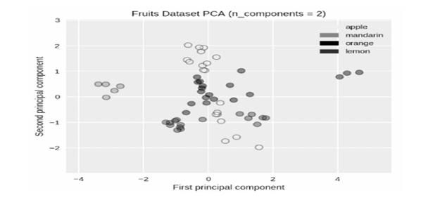
PCA
Principal component analysis

Slide 14
Manifold Learning
A class of unsupervised learning that aims to classify datasets as low-dimensional manifolds enclosed in high-dimensional spaces is called manifold learning.
Manifold learning is also known for its visualizations. One commonly used method of manifold learning is called multidimensional scaling (MDS).
There are many types of MDS, but they all have a general aim: to visualize a high-dimensional space and project it into a lower dimensional space.
In this way, the high dimensional data can be visualized using its clustering behavior (Figure).
Similar to the PCA, each feature needs to be normalized so that its features possess zero mean and unit variance.
Once you have imported MDS class from sklearn.manifold and converted your input data, you can create an MDS object, defining the number of dimensions(components) − usually assigned as two for visualization.

Slide 15
Manifold Learning
from adspy_shared_utilities import plot_labelled_scatter
fromsklearn.preprocessing import StandardScaler
fromsklearn.manifold import MDS
# each feature should be centered (zero mean) and with unit variance
X_fruits_normalized = StandardScaler().fit(X_fruits).
transform(X_fruits) mds = MDS(n_components = 2)
X_fruits_mds = mds.fit_transform(X_fruits_normalized)
plot_labelled_scatter(X_fruits_mds, y_fruits, ['apple', 'mandarin', 'orange', 'lemon’])
plt.xlabel('First MDS feature’)
plt.ylabel('Second MDS feature’)
plt.title('Fruit sample dataset MDS');

Slide 16
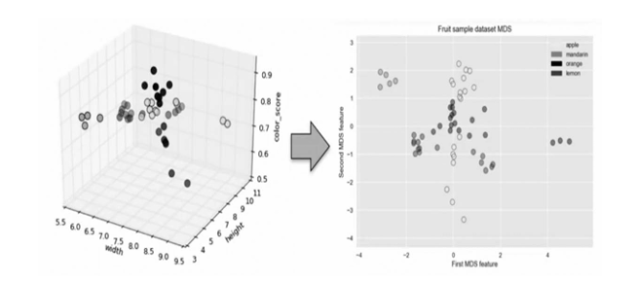
Manifold Learning
High-dimensional dataset to two-dimensional dataset

Slide 17
Manifold Learning
A particularly beneficial manifold learning algorithm to visualize the data is called the t-distributed stochastic neighbor embedding (t-SNE) algorithm.
t-SNE uses a two-dimensional depiction of the data points so that the distances within the points in the 2D scatterplot correspond as closely as possible to the distances between the same data points in the high-dimensional space.
In particular, t-SNE gives significant emphasis to preserve knowledge about distances between neighboring data points.
The code is very similar to that of MDS and essentially only replaces MDS with t-SNE. t -SNE seems to function best on datasets with a more excellently defined local structure (Figure).

Slide 18
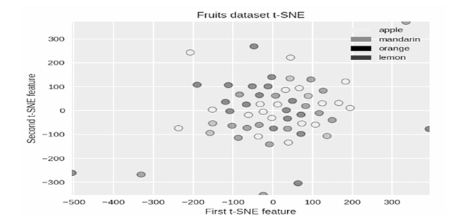
Manifold Learning
:from sklearn.manifold import TSNE
tsne = TSNE(random_state = 0)
X_tsne = tsne.fit_transform(X_fruits_normalized)
plot_labelled_scatter(X_tsne, y_fruits, ['apple', 'mandarin', 'orange', 'lemon’])
plt.xlabel('First t-SNE feature’)
plt.ylabel('Second t-SNE feature’)
plt.title('Fruits dataset t-SNE');
Implementation of t-SNE algorithm

